Slide 1
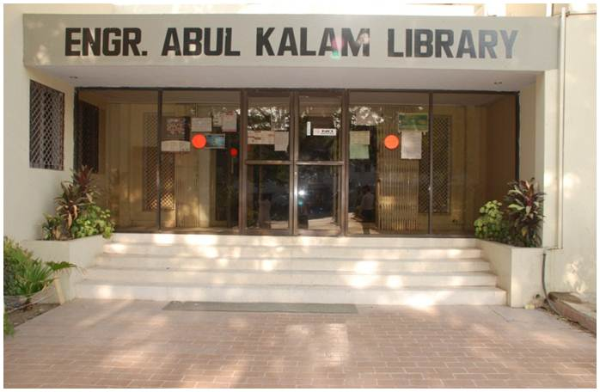
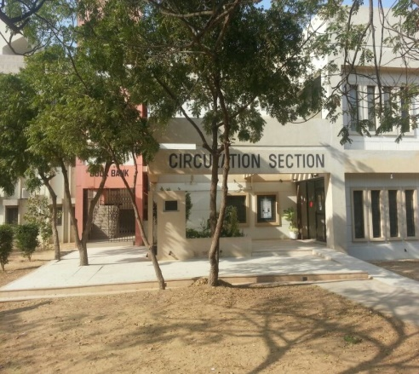
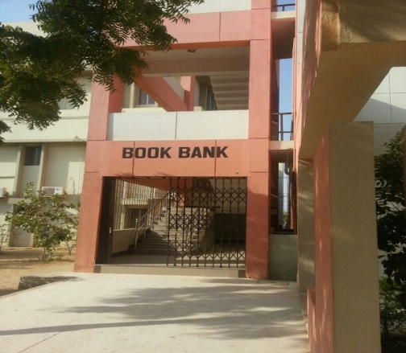
ENGR. ABUL KALAM LIBRARY

Slide 2
ENGR. ABUL KALAM LIBRARY
NED University of Engineering and Technology
Email: libadmin@neduet.edu.pk
Website: https://library.neduet.edu.pk

Slide 3
Introduction
Library is a place where books and other printed or non-printed materials are kept for the purpose of reading, studying and consulting in an organized way to achieve some task and goals
Engr. Abul Kalam Library provides multiple services at a common place with following objectives
To provide maximum possible information resources to the users.
To equip student with basic skills to obtain and use wide range of resources and services.
To lead them (students) towards a lifetime use of Libraries for recreation, information and continuing education.
To ensure maximum access to the widest possible range of resources and services.

Slide 4
Library Facilities
Borrowing Books (Circulation & Book Bank)
Reference and Periodical Sections
Non Book Material (e.g. CDs/DVDs, Electronic Material, etc.)
Online Learning Resources / Digital Library
Separate Reading Halls for Group Studies
Printing, Photocopying, Scanning & CD Copying Facilities

Slide 5
Library Sections
Circulation Section
Issue books for 21 days
Books must be returned before due date to avoid any penalty
Book Bank
Text books are issued for entire semester
Schedule is announced on departmental notice boards
Issue up to 6 books for semester @ less than 10% of the cost of book
Books must be returned before due date otherwise registration will be suspended for the next semester
Friend’s corner: Free books
Reference Section
Studying within Library Premises
Books, Dictionaries, Encyclopedias, Handbooks, Manuals, etc.

Slide 6
Library Sections (Continued)
Digital Library
45+ Computers available
General purpose & Engineering Softwares (e.g. Microsoft office, AUTOCAD, MATLAB)
Printing and Scanning Facilities
Government Documents Section
Acts & Ordinances, Census Reports, Planning Reports & Budgets, Policies, Service Rules, Statistical Reports, Survey Reports, etc.
Periodical Section
Magazines, Newsletters, Research Journals/ Articles
Newspapers (08 daily newspapers in three languages English, Urdu & Sindhi)
Non Book Material Section
CDs/DVD’s writing facility available, Electronic materials accompanying with library books, Application Software on CDs

Slide 7
Library Online Resources
Website: https://library.neduet.edu.pk/ [ for detail information ]
Search Library Resources
Online search for available books, journals, and other material
Digital Resources (E-resources)
E-books, Dissertations & Thesis, Journals, Standards, Databases
Complete guide for Library Digital Resources available on library website
University Library Portal
Search library resources through portal
View details of borrowed books with due dates and online renewal options

Slide 8
Library Policies
Student’s are required to get library membership card
Two Passport Size Photograph, Xerox of University ID Card
If card is lost, a duplicate card is issued (at fine of Rs.50.00)
Overdue Charges
The book must be returned on or before due date otherwise fine will be charged @ Rs 10.00 Per book per day
If books are not returned by due date, registration in next semester may be suspended
Price Recovery/Replacement of Book
As a result of any damage or loss of Library material the borrower shall be liable to replace it with new one, or pay double the prevailing market price or as decided by Library Committee.

Slide 9
Library Policies (Continued)
Library Services Hours
Main campus: 8:30 am to 9:00 pm
City campus : 8.30 am to 6:00 pm
LEJ campus : 8:30 am to 4:30 pm
Need to show University ID card upon entrance to library
All library collection is protected through security gates
For safety, surveillance cameras are installed at bag counter
Book Fair: Every year library arranges on-campus Book Fair
Purchase books or recommend for purchase in library
University I.D card is mandatory for library No Dues Clearance

Slide 10
Thank You

